Slide 1
if Statements – AND | OR

Slide 2
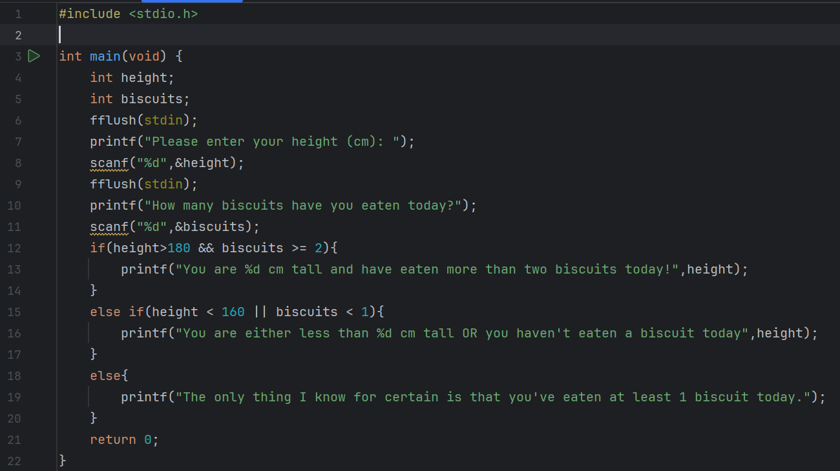
Predict
What do you think this code does?
Asks the user to enter their height in cm and how many biscuits they have eaten today. If they are taller than 180 cm and had eaten more than 2 biscuits it outputs their height and that they have eaten more than 2 biscuits. If they are shorter than 160 cm or they have eaten less than one biscuit, it outputs this to them. For the other combination it outputs that they have eaten at least 1 biscuit today.

Slide 3
Run
What does the code do?
Asks the user to enter their height in cm and how many biscuits they have eaten today. If they are taller than 180 cm and had eaten more than 2 biscuits it outputs their height and that they have eaten more than 2 biscuits. If they are shorter than 160 cm or they have eaten less than one biscuit, it outputs this to them. For the other combination it outputs that they have eaten at least 1 biscuit today.
Does this match your prediction?
Yes
Download the code from Github and run it!

Slide 4
Investigate
Investigation Activities
What are the names of the variables being used? Height, biscuits What data types do they hold? Integers(whole numbers) Add comments to lines 4-14 to explain what each line of code does. What does fflush(stdin) do? clears the output buffer and moves buffered data to the console or or disk in case of file output stream

Slide 5
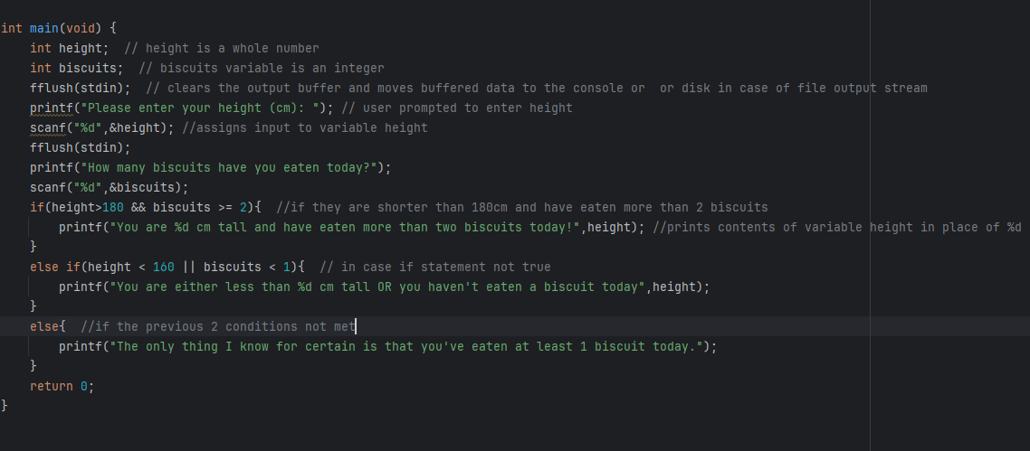

Slide 6
Modify
Modification Activities
Change the program to detect if somebody is over 170cm instead. Add an additional conditional statement and output for if the person has eaten more than 5 biscuits. Add an additional variable of age and include this in the conditional statements and outputs.

Slide 7
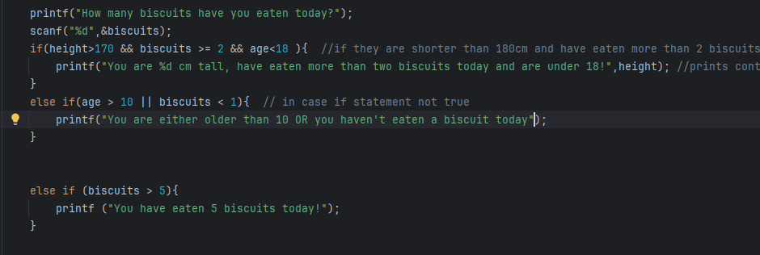

Slide 8
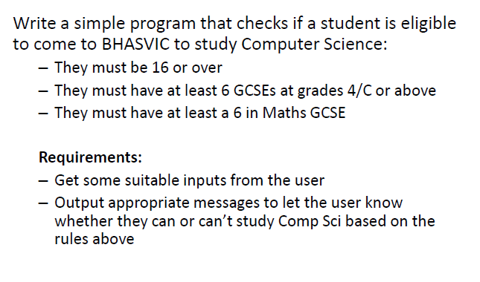
Make
Make Activities

Slide 9
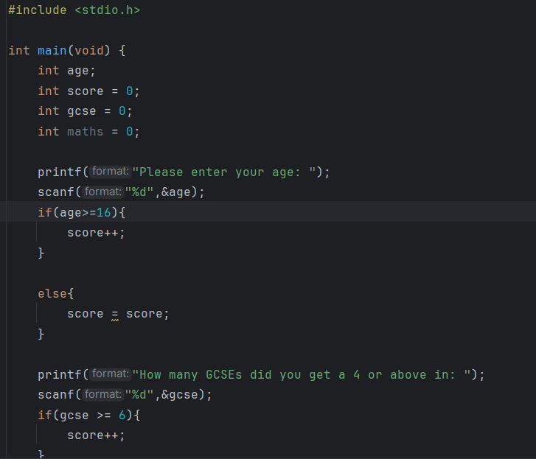
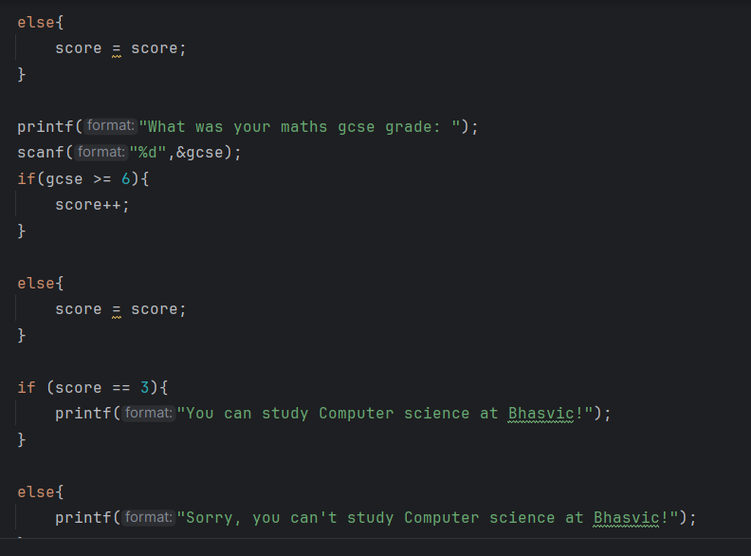
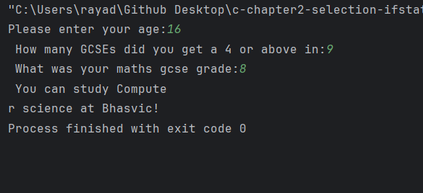

Slide 10
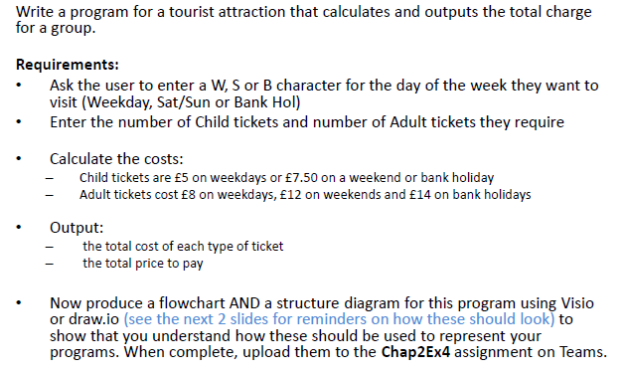
Make
Make Activities

Slide 11
